Slide 1


Intelligent Surveillance Solution for Suspected Abandon Objects
YANGON TECHNOLOGICAL UNIVERSITY DEPARTMENT OF COMPUTER ENGINEERING AND INFORMATION TECHNOLOGY
Date: 19 -3 -2019
Supervised by
Daw Myat Thida Tun
Associate Prof. (YTU)
Presented by
Hsu Pyae Lwin
ME.CEIT - 3 (13th batch)

Slide 2
Outlines
Introduction
Former researches
Problem statement
Objectives
Aims
System design
Methodology
Results and discussion
Future Development

Slide 3
Introduction
Intelligent video surveillance offers a promising solution to the problem of dynamic visual surveillance.
Abandoned objects detection is one of the popular entities including every visual surveillance system.
It is very challenging to watch over the public places with crowds by security guards and identify the abandoned objects that have been left by a person.
The proposed system is one of the interesting abandoned detections on video surveillance.
The proposed system not only detects abandoned objects but also classifies the objects.
The main objective of the system is to detect security-suspected objects such as bags, books, luggages and etc. in public area.

Slide 4
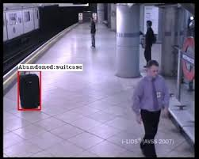
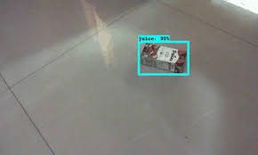

Sample unattended object

Slide 5
Former researches
No. | Author | Name | Methodology | Advantages | Disadvantages
1. | Devadeep Shyam Alex Kot Chinmayee Athalye | Abandoned Object Detection Using Pixel-Based Finite State Machine And Single Shot Multibox Detector(2018) | sViBe background modeling Pixel-based Finite State Machine (PFSM) Single Shot MultiBox Detector(SSD) | Efficient computation Efficient removal of shadows from the foreground Robust to illumination changes | Fails when background and foreground objects have a similar texture and color

Slide 6
Cont’d
No. | Author | Name | Methodology | Advantages | Disadvantages
2. | Meenal Bargath Monika Verma Ritika Shalini Vishwakarma Ruchi Biswas Shailendra Singh | Abandoned Object Detection(2017) | Background Subtraction algorithm Region of Interest (ROI) Morphological Closing Blob Analysis | Successful detection in the colour match of object and background. Accurate decision making Owner identification | Not well creation for high-level semantic descriptions of the object actions

Slide 7
Cont’d
No. | Author | Name | Methodology | Advantages | Disadvantages
3. | YingLi Tian Rogerio Feris Haowei Liu Arun Humpapur Ming-Ting Sun | Robust Detection of Abandoned and Removed Objects in Complex Surveillance Videos (2017) | Three Gaussian mixture models A matching method based on the type of the static regions and user- defined parameters | Shadow removal Quick lighting change adaptation Well recognition about abandoned and removed objects. | Limitation for small or occluded abandoned object False-alarm for adverse weather conditions

Slide 8
Problem statement
The problem is that abandoned object is undefined when any motion exists in camera sense.
Failure happens when background and foreground objects have a similar texture and color.
It doesn’t work well for high-level semantic descriptions of the object actions.
Small or occluded abandoned objects are limited
False-alarm rises up for adverse weather conditions

Slide 9
Objectives
To define abandoned correctly if a person passed by the object without picking it up
To precisely detect only the target abandoned objects within a limited time

Slide 10
Aims
To monitor the security of that area for keeping citizens safe.
To upgrade to a better living standard such as smart surveillance system

Slide 11
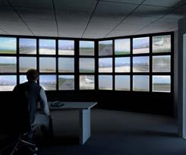
System design
stationary object >120s?
Yes
Stationary obj classification (SVM)
Start
No
No
Declared abandoned obj and alert by alarm
moving object?
Video Input
End
Converting RGB to Gray
Yes
Motion Object Tracking (Kalman Filter)
Background Subtraction(GMM)
Assigning ROI regions
Image Refilling(Mophological operation)

Slide 12
Methodology
Gaussian Mixture model for background subtraction
Morphological operation for image enhancement
Kalman filter for object tracking
Support vector machine for object classification

Slide 13
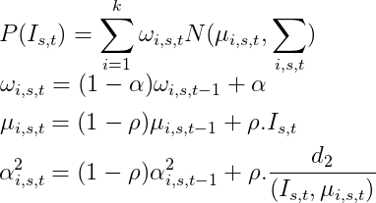
GMM Result for Background subtraction
The colors of each background pixel are modeled by a mixture of K Gaussians.
several conditions such as, waving trees, rippling water, and illumination changes.
accuracy up to 97.9% from the IEEE 1062-922X 2013

Slide 14

Kalman Filter Result for Object Tracking
efficient tracking of multiple moving objects under the confusing situations: inter-object occlusion, occlusion of the ocjects by background obstacles, splits and merges

Slide 15
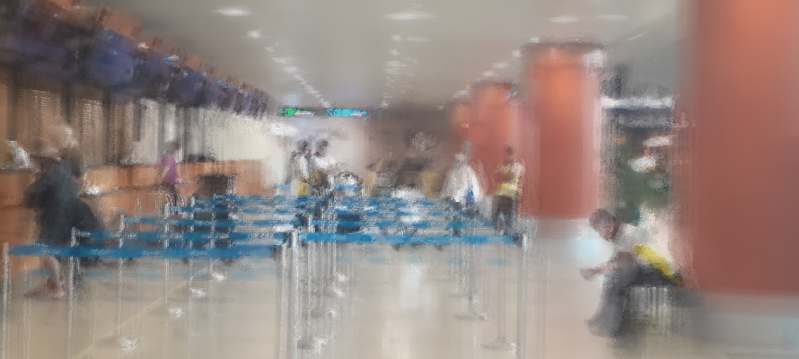
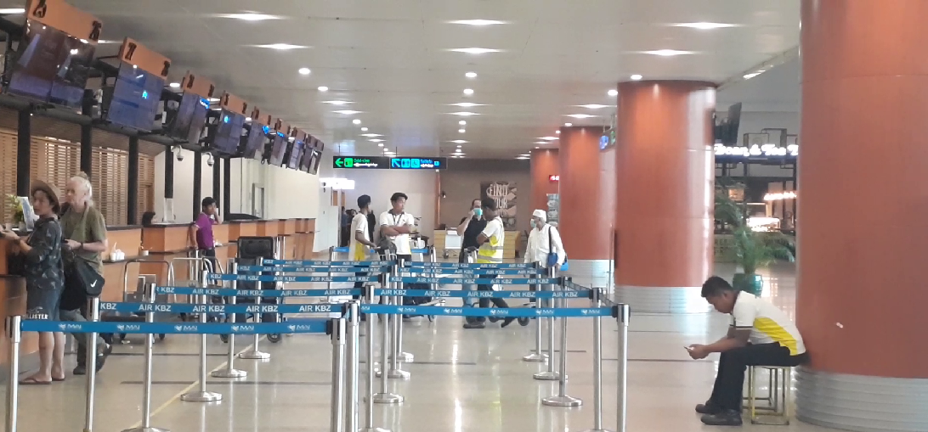
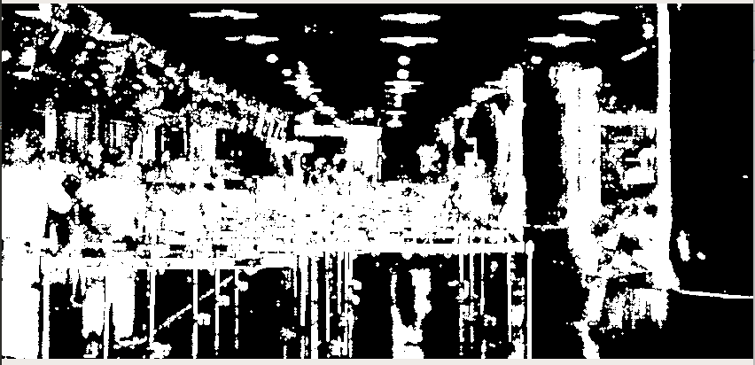
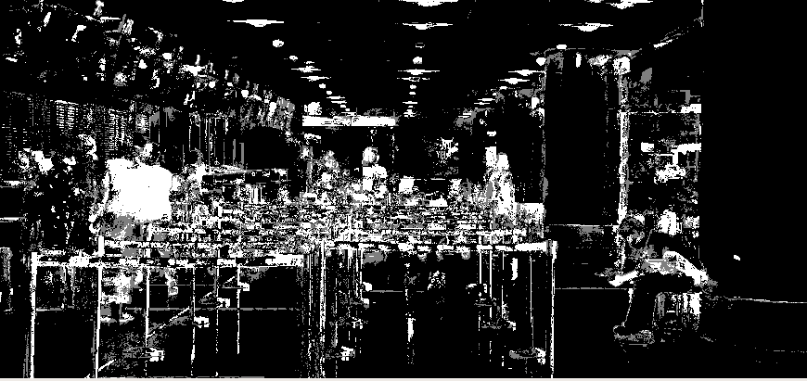
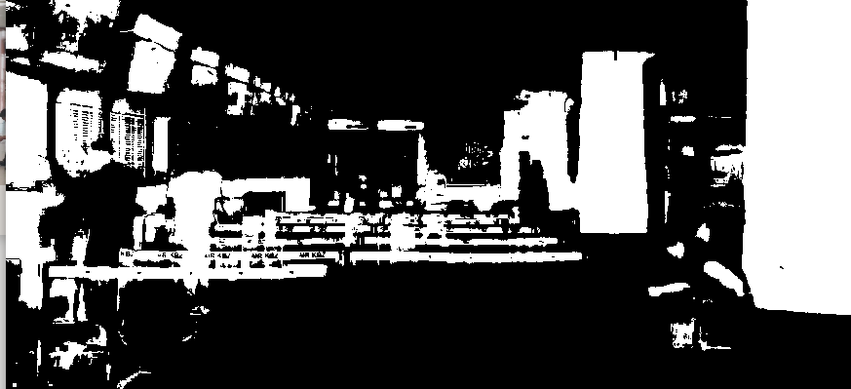
Results and Discussion
GMM
background
Input
foreground
Motion object tracking
Kalman
filter
Image refilling(foreground)

Slide 16
Future Development
A high-level semantic descriptions about various abandoned objects.
Better accuracy in detecting abandoned objects of complex environment with multiple moving objects.

Slide 17
Thank you for your time….

